Slide 1

Sprocket Central Pty Ltd
Sakshi Shinde

Slide 2
Agenda
Introduction
Data Exploration
Model Development
Interpretation

Slide 3
Introduction
Sprocket Central Pty Ltd , a medium size bikes & cycling accessories organisation, has given us a new list of 1000 potential customers with their demographics and attributes.
We need to recommend which of these 1000 new customers should be targeted to drive the most value for the organisation.
Steps taken -
Data Exploration - gained insights into the data, identified trends, and formulated hypotheses for further analysis
Model Development - Deploying proposed model to carry out the meet the required performance standards and delivers value to users and the organization.
Interpretation - Extracted meaningful and actionable information from the data.

Slide 4
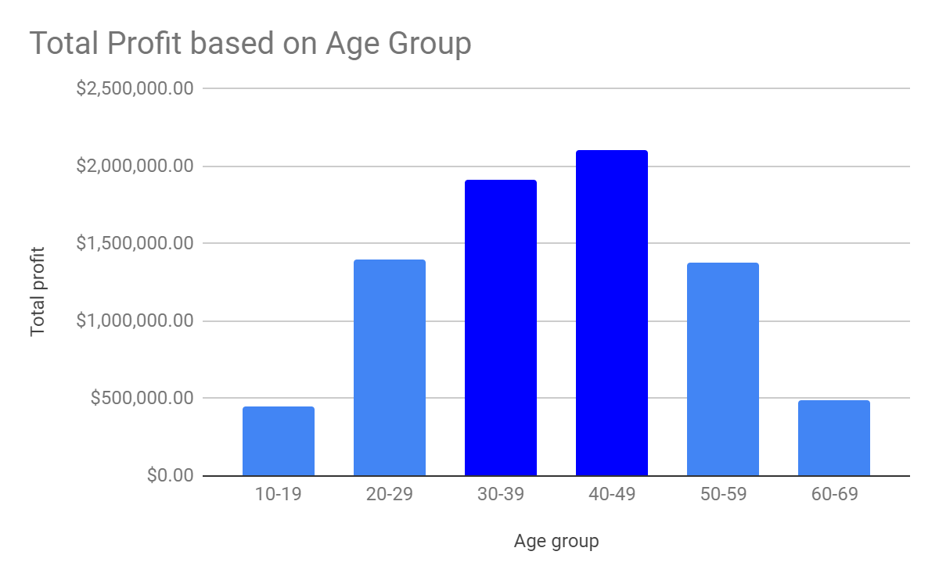
Data Exploration
Total Profit based on different Age Groups
Insights:
The customers between 30 to 49 age are the most profitable in terms of recent transaction history with more than 19 lacs profit.

Slide 5
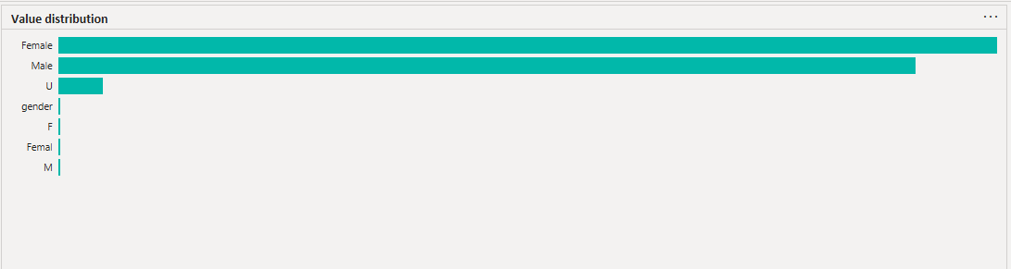
Data Exploration
Average Profit in the year 2017 by Gender
Insights:
Male customers are more profitable in
the between the mid year i.e. April
- July while female customers are
showing sligh peak around october.

Slide 6
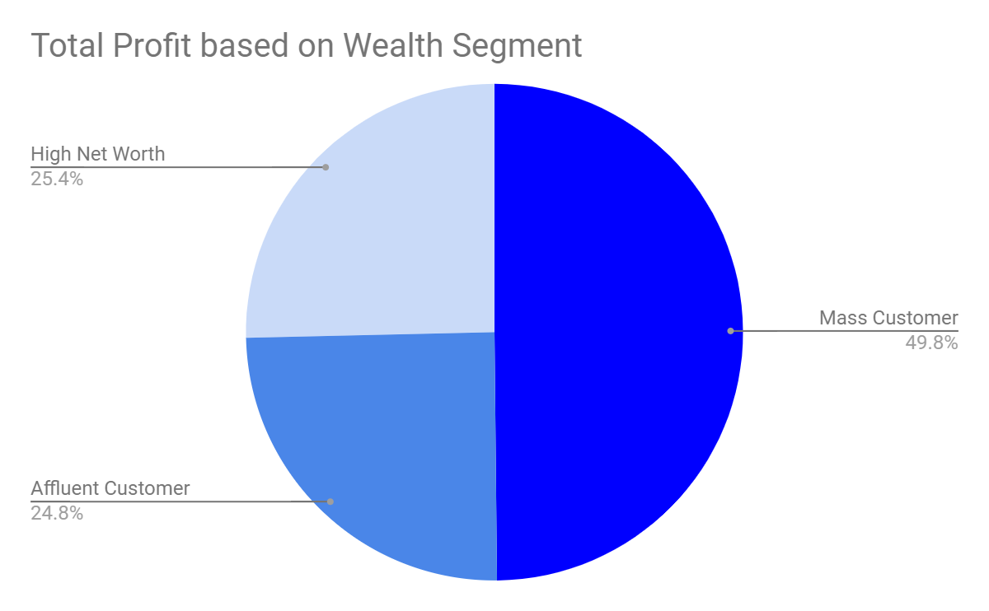
Data Exploration
Total Profit based on Wealth Segment of customers
Insights:
The mass customer are the most profitable segment among the three segments as nearly 50% of the profit is made by this segment.

Slide 7
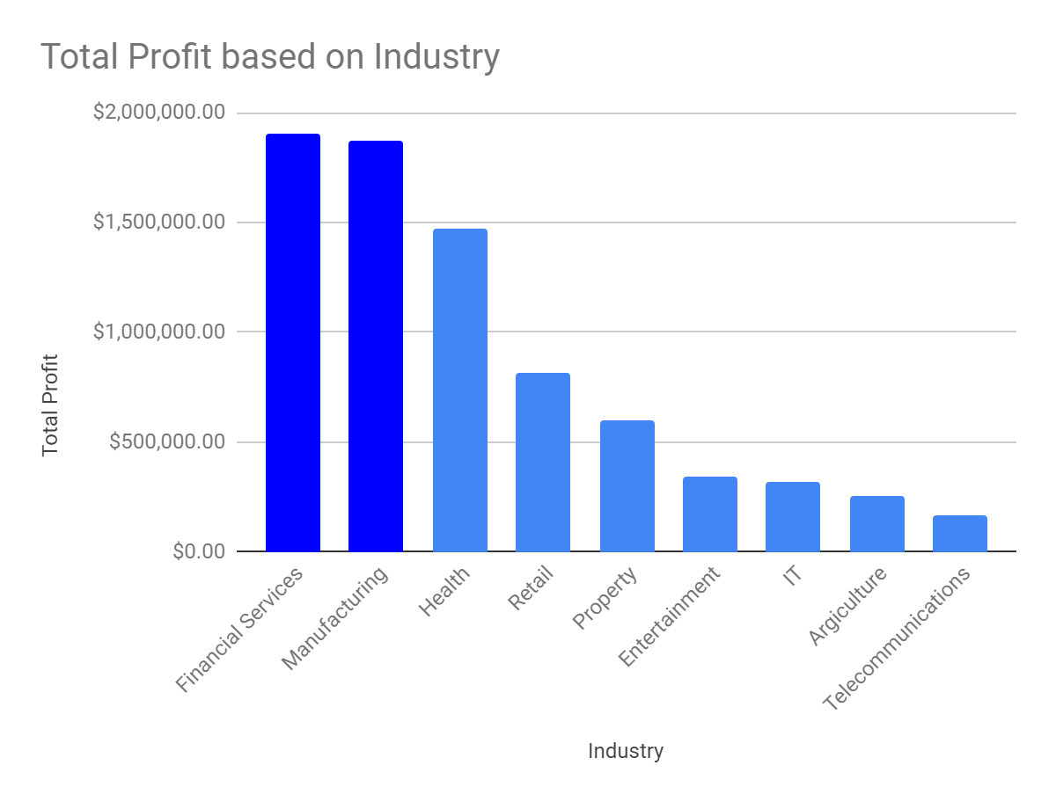
Data Exploration
Total Profit based on customers Industry
Insights:
The customers related to Financial Service and Manufacturing showing most profit with 18 lacs + profit.

Slide 8
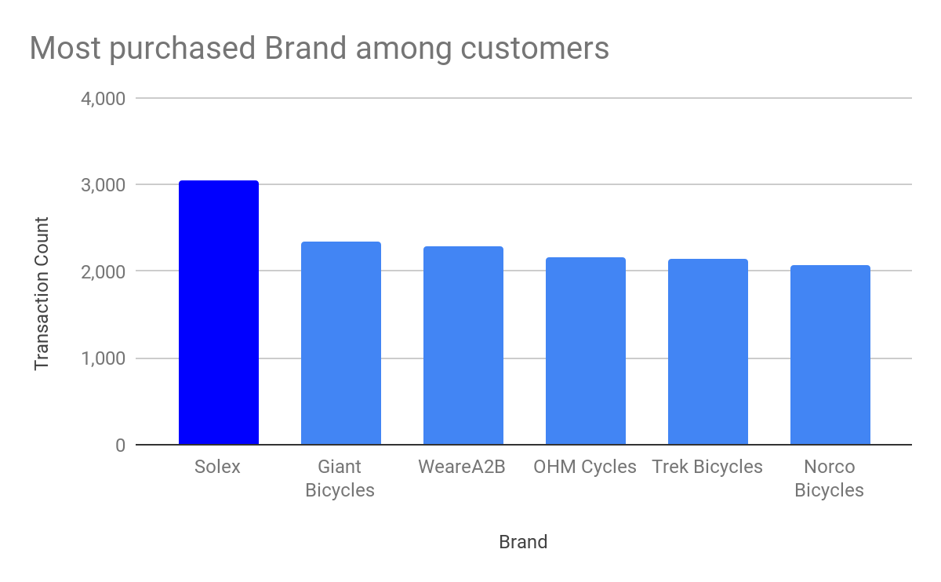
Data Exploration
Most purchased brands among customers
Insights:
Customers buys more Solex brand among the other brands with transaction count of more than 3000.

Slide 9
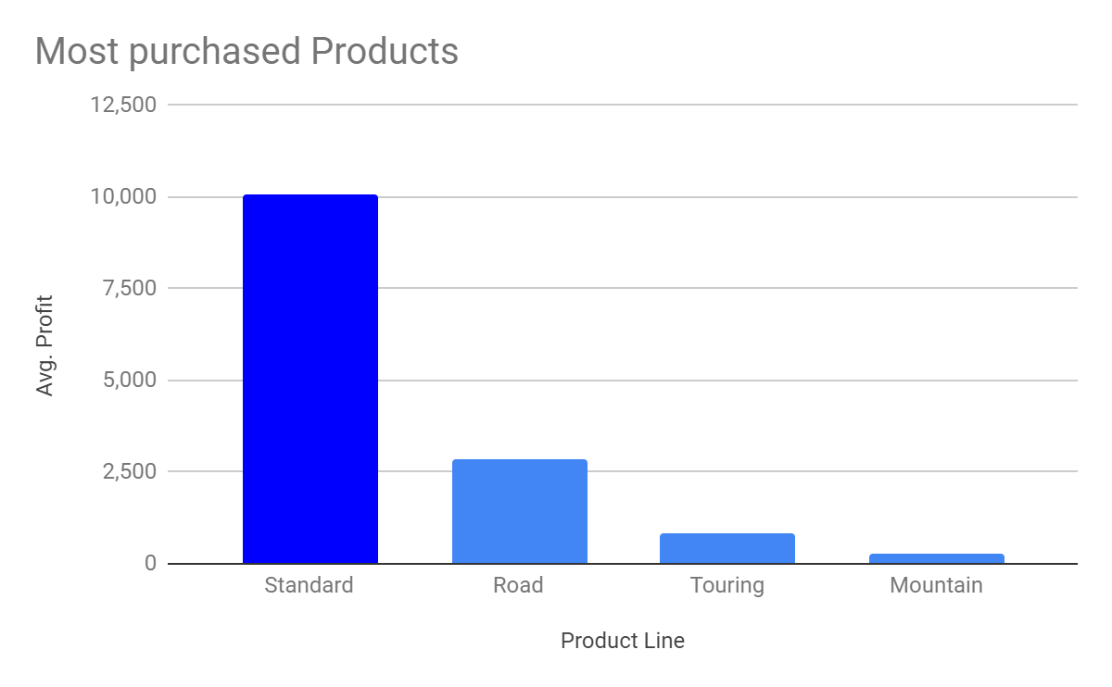
Data Exploration
Most purchased products among customers
Insights:
Standard product are most buyable products by customers among the other product with more than 10000 + transactions took place

Slide 10
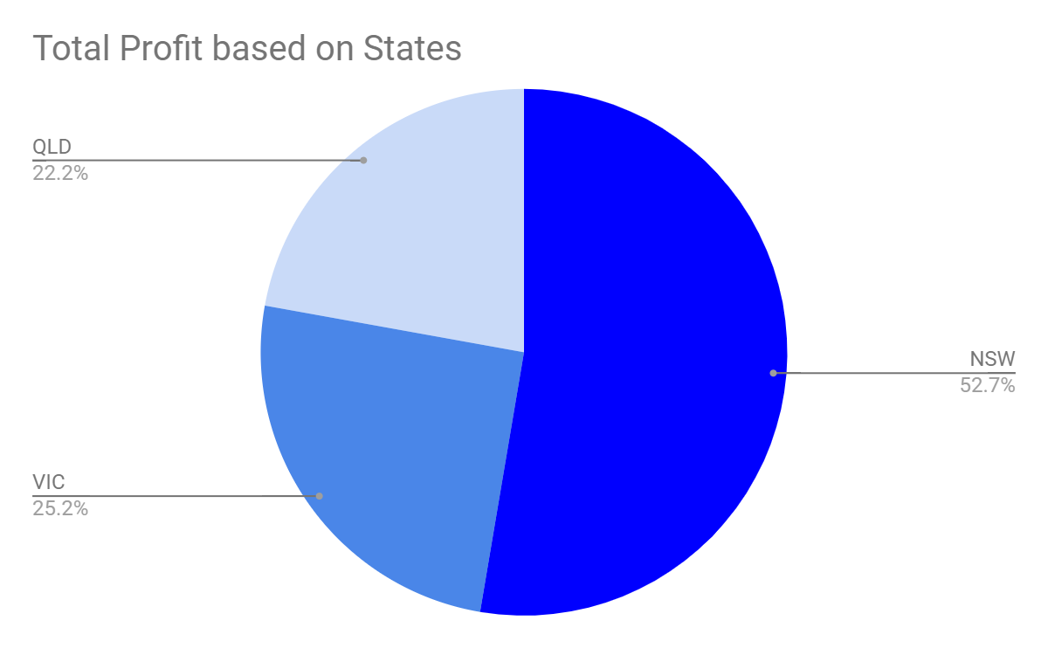
Data Exploration
Total Profit based on States in Australia
Insights:
Customers living in New South wales are the most profitable customers with more than 50% profit among the other States.

Slide 11
Model Development
Marketing team should deploy the targeted model based on -
Customer between age 30 to 49.
Male customers in the mid-year between April - July and in midweek around Thursday.
Female customers around october and in the start of the weekend, Saturday.
Customers in the Mass Consumer Segment.
Customers related to Financial Services and Manufacturing Industries.
Solex brand and Standard product as the top priority.
Customers living in New South Wales.

Slide 12
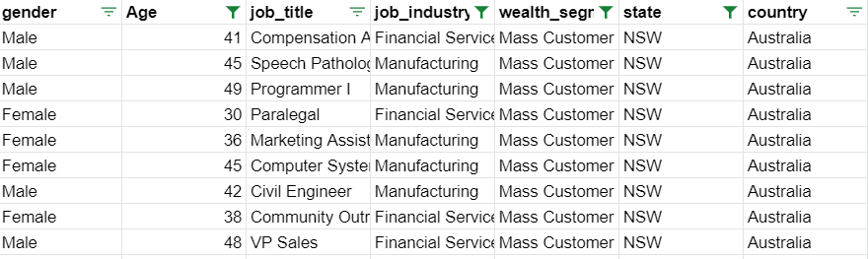
Interpretation
After filtering the targeted customers from the New Customer List, it will look like below

Slide 13
Thank You

